Slide 1
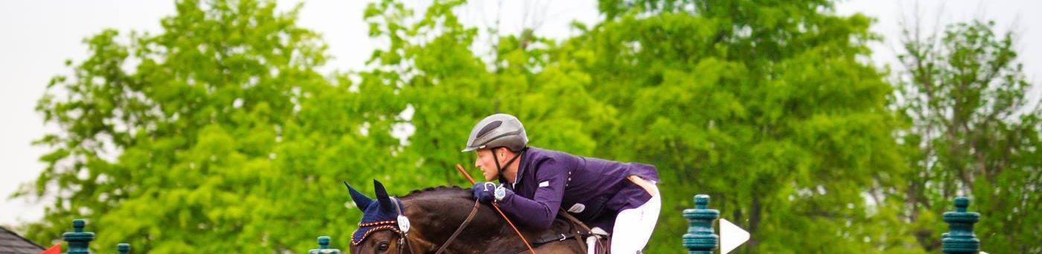
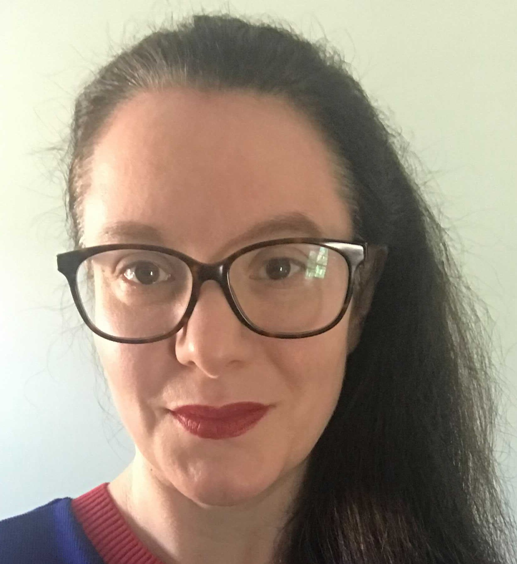



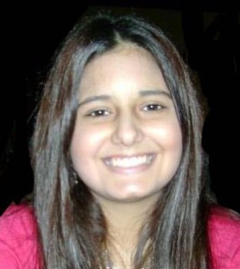
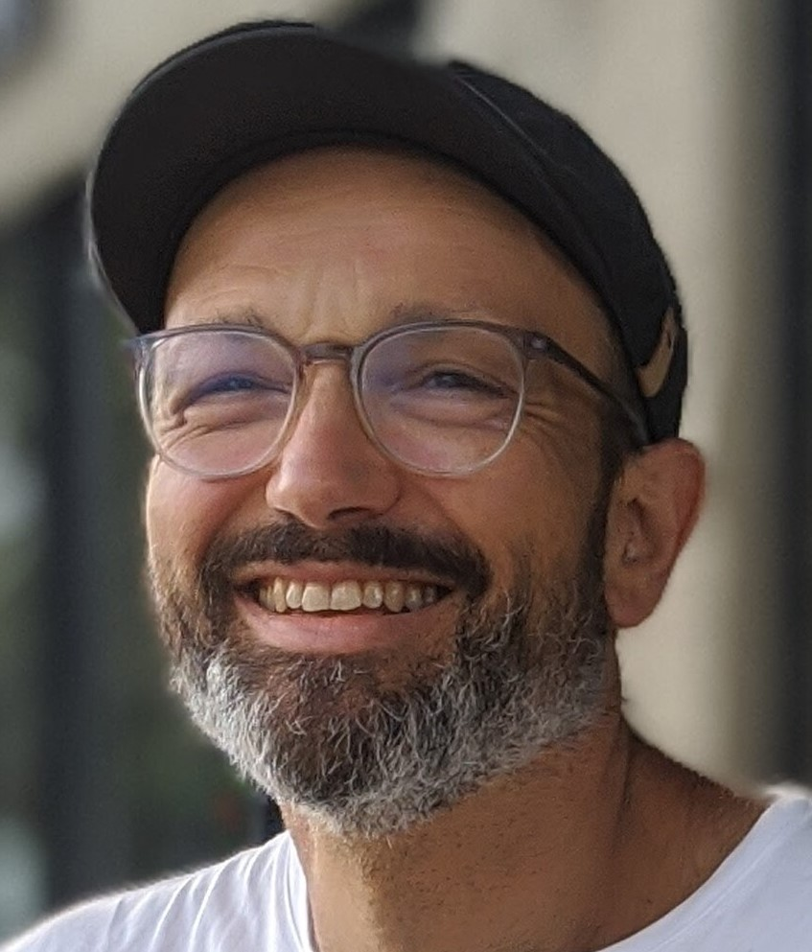
HORSEPOWERED MACHINE LEARNING Safer Eventing Through Machine Learning & Data Analysis
The Boot Camp at UNC-Chapel Hill
Virtual Demo Day
HEATHER
ALLARDICE
JOCELYN
CONARD
NATE
KELLY
MEGAN
CROSS
ELIZABETH
PASI
ALESSANDRO
TRAVAGLIA

Slide 2
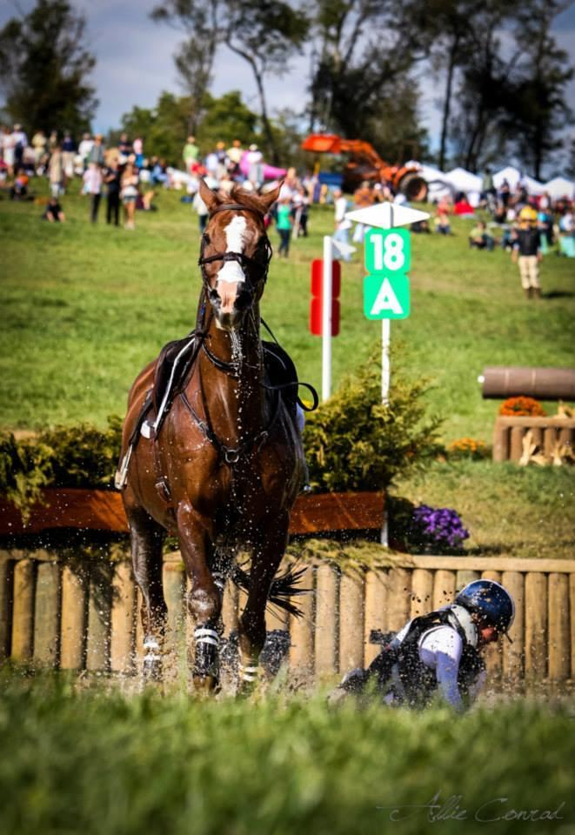
PROJECT OUTLINE
Applying ML sequential modeling, Bayesian frameworks, weather modeling and data wrangling to predict conditions increasing horse falls during competitions.
Background
During eventing equestrian competitions, horse falls are rare yet serious parts of the sport
ER records report serious injuries associated to horse falls
Project Goal
Develop a model using ML to predict conditions that may increase risk of fall
Use real data from USEA recognized event results
Data set will be expanded in the future through surveys currently being implemented by project team
Challenges
Data are sparse and messy – response rate is very small
Predicting rare events is difficult

Slide 3
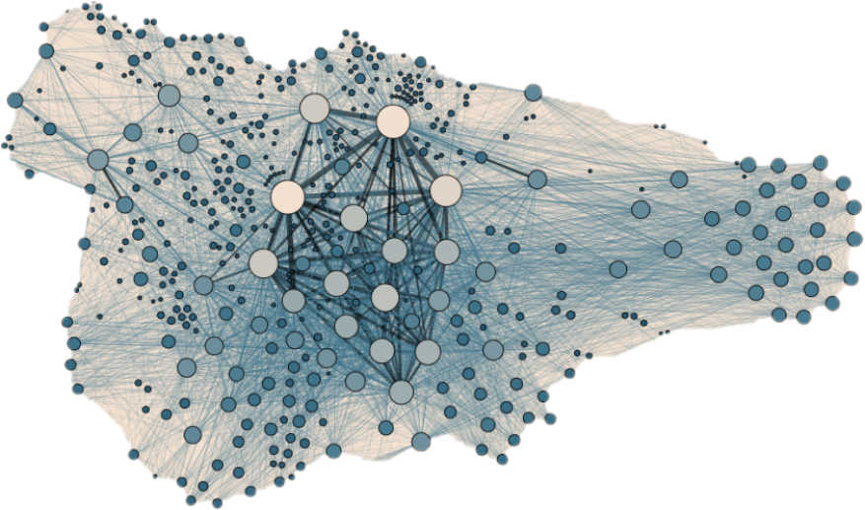
CODING OVERVIEW
Applying ML sequential modeling, Bayesian frameworks, weather modeling and data wrangling to predict conditions increasing horse falls during competitions.
Obtain real data from equestrian triathlons
Data wrangling/cleaning
Replace missing data
Bayesian modeling framework to develop missing data in the original dataset
Forecast horse falls
Deep learning sequential model

Slide 4
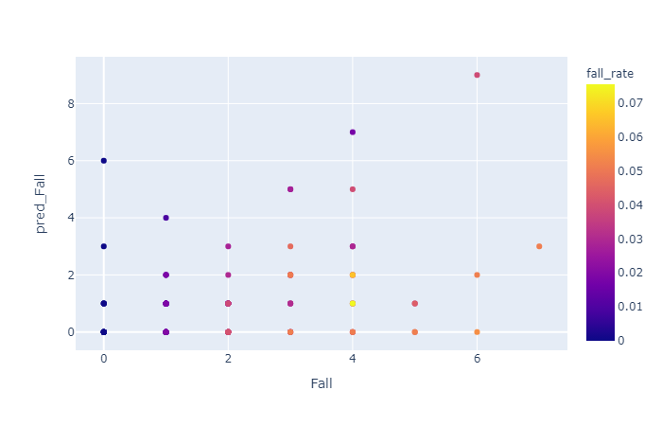
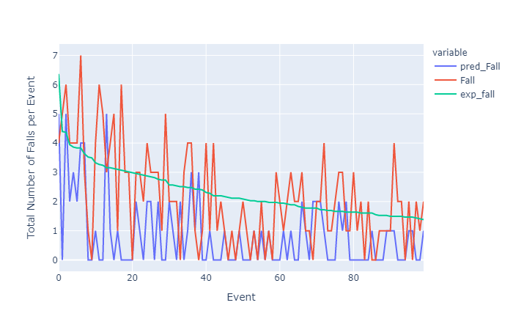
MACHINE LEARNING DEEP LEARNING SEQUENTIAL MODEL
Applying ML sequential modeling, Bayesian frameworks, weather modeling and data wrangling to predict conditions increasing horse falls during competitions.
Tensorflow Keras Sequential Model
Over 55k rows of cleaned data (rider, horse, event, dressage score, etc)
We added: weather and location from API data
Mix of categorical and scalar data
Tensorflow Keras Sequential model
Results
Wind speed, visibility, and precipitation were found to be significantly associated with falls

Slide 5
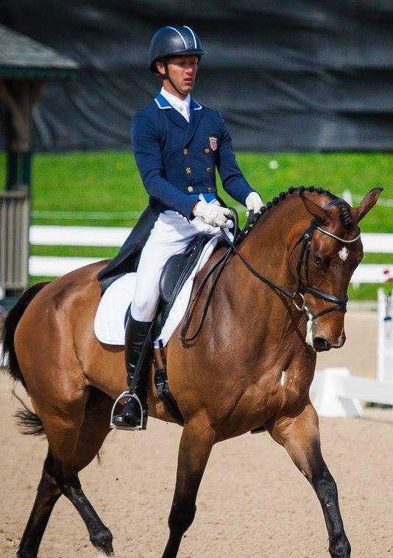
CONCLUSIONS
AND NEXT STEPS
Applying ML sequential modeling, Bayesian frameworks, weather modeling and data wrangling to predict conditions increasing horse falls during competitions.
Developed online survey for active riders
Continue expanding data set with survey results
Refine modeling to increase awareness and improve safety
https://us-eventing.herokuapp.com/

